Slide 1

Web API

Slide 2

Content Of Web API
What is Web API?
RESTful services
Endpoints
HTTP methods
What is REST endpoints?
What is Http Status Codes?
Http Headers
Http Headers
Return type in API Actions
Content Negotiation
CORS

Slide 3
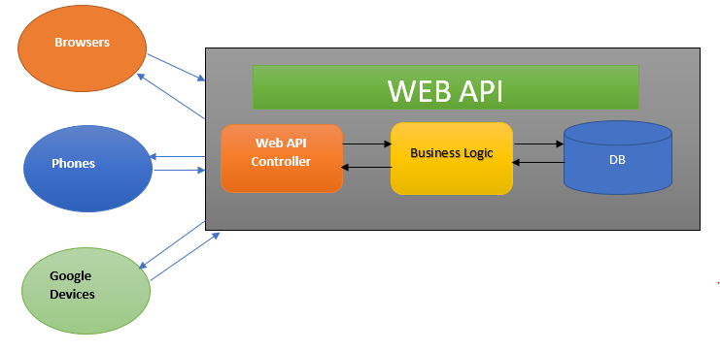
What is Web API?
Its a framework or technology to develop RESTful services
RESTful services are similar to SOAP based web services
Now, the front-end frameworks mostly use REST services, becoz it can be invoked directly using the URL.
REST services are using the features of HTTP protocol

Slide 4
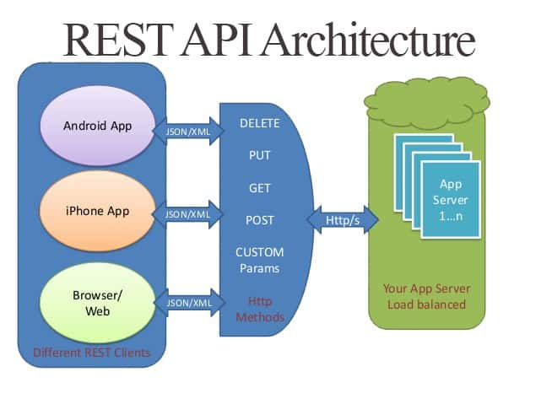
RESTful services
Representational State Transfer
Completely HTTP Based
It used HTTP protocol as communication protocol
Uses HTTP methods and URL to identify the action to invoke
Supports different content types - XML and JSON (also can support other formats like CSV)
Http Headers can be used for deciding the data format - Accept and Content-Type

Slide 5
Endpoints
It is the combination of HTTP method and Url that points to an action
HTTP methods
GET -> Read data from server (Reqeust data from server)
POST -> Create a new entry or file in server
PUT -> Replace and existing file / entry in server. (Usually used in update )
PATCH -> Update the entry in server.
DELETE -> Remove an entry/file from server.
OPTIONS -> Used to check the support for operations(Check which of the Http operations are supported)

Slide 6
What is REST endpoints?
GET
GET http://localhost:5000/api/Products -> ProductController/GetProducts()
Read all products
POST
POST http://localhost:5000/api/Products -> ProductController/AddProduct()
Add a new product to stock
GET
GET http://localhost:5000/api/Products/10 -> ProductController/GetProduct(int id)
Read a single product from server with id 10
PUT
PUT http://localhost:5000/api/Products/10 -> ProductController/UpdateProduct(int id)
Updates an exiting record with Id 10
DELETE
DELETE http://localhost:5000/api/Products/10 -> ProductController/DeleteProduct(int id)
Deleting a single product with id 10
GET
GET http://localhost:5000/api/Products/brand/samsung -> ProductController/Search(string brand)
Search products by brand name

Slide 7
What is Http Status Codes?
Status codes indicates the process execution status or response status.
Before processing the response data we need to evaluate the status code.
2xx -> Success operations
200 - OK
201 - Created
204 - No Content
3xx - Redirection (used in web sites)
304 - Temporary redirection
305 - Cached redirection
307 - permanent redirection
4xx - Client side error
404 - Not Found
401 - Unauthorized
403 - Access Denied
400 - BadRequest
5xx - Server side error
500 - Internal Server Error
501 - Timed out

Slide 8
Http Headers
The reqeust and response contains headers
Headers are key-value pair entries
Used to specify the metadata or additional informations about request or response data.
Content-Type
Present in Request and Response
Specifies the type of the data you sent or receive.
Content-Type : application/json
Content-Type : text/xml
Content-Type : text/html
Accept
Determines the Response content-type
It is present in reqeust header only

Slide 9
Return type in API Actions
Primary types - String, int, boolean, float
User defined types - classes and structures
Collections - IEnumerable
ActionResult<T>
Task<ActionResult<T>> for Async

Slide 10
Content Negotiation
By default the API server send the response using the default formatter.
In .NET Core it uses application/json or text/json as the default formatters.
Client can request for a specific content format using Accept header.
API server checks the valid formatter available to format the data in requested content type.
Response - If the formatter is not available it uses the default formatter.
Request - If incoming data format is not supported the api will return 415-Media Type not supported

Slide 11
CORS
Cross Origin Resource Sharing
It is a security policy implied by the framework to protect APIs from external domains.
Provide access to APIs from configured domains with controlled access.
Limit the access to operations by defining allowed methods.
Microsoft.AspNetCore.Cors package is used to configure the CORS policy.
Configure the CORS service and CORS middleware.

Slide 12
THANK YOU

